Slide 1

MANGALORE INSTITUTE OF TECHNOLOGY &
ENGINEERING
(A Unit of Rajalaxmi Education Trust®, Mangalore) Autonomous Institute affiliated to VTU, Belagavi, Approved by AICTE, New
Delhi Accredited by NAAC with A+ Grade & ISO 9001:2015 Certified Institution
DEPARTMENT OF INFORMATION SCIENCE AND ENGINEERING
ATTENDANCE MANAGEMENT SYSTEM USING FACIAL RECOGNITION
TEAM MEMBERS: NIKHIL U
ABHISHEK S POOJARY
NIKHIL
ADITHYA S RAO

Slide 2
ATTENDANCE MANAGEMENT SYSTEM
Traditional attendance methods, such as manual roll calls or card-based systems, are often time-consuming, prone to errors, and susceptible to manipulation (e.g., buddy punching, where one person clocks in for another). With facial recognition, the process becomes streamlined, reducing the time it takes to mark attendance and minimizing inaccuracies.
The system works by using cameras and Python algorithms to identify each person’s unique facial features. When someone arrives at the designated location, the system captures an image, compares it with stored profiles, and automatically records the attendance if a match is found. This eliminates the need for individuals to carry ID cards or remember passwords, making the system more convenient and secure.
Furthermore, facial recognition attendance systems can operate in real-time, meaning attendance is recorded instantly. This is beneficial for organizations needing quick data access, as administrators can view attendance reports without manually compiling data. Additionally, these systems can enhance security, as only registered individuals are allowed to check in, preventing unauthorized access.
Overall, integrating facial recognition technology modernizes attendance management, making it faster, more reliable, and adaptive to the needs of modern workplaces, schools, and events.

Slide 3
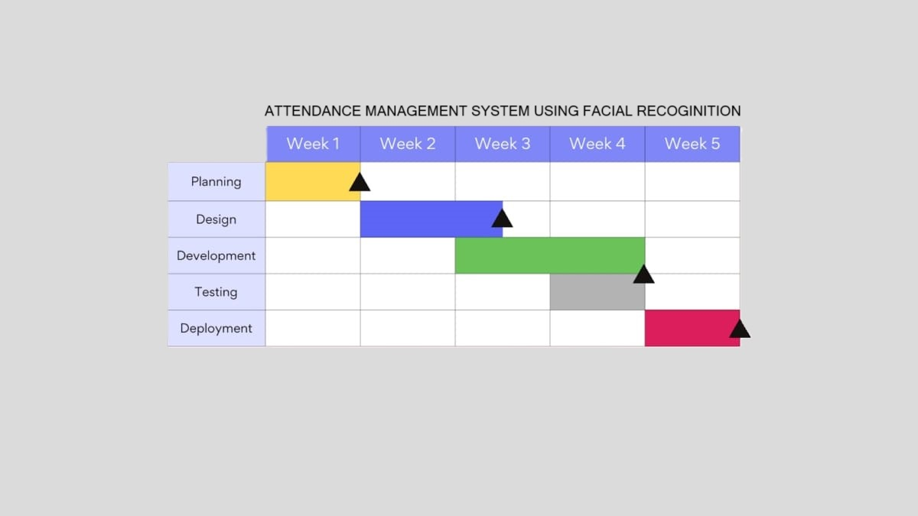
Gantt Chart

Slide 4
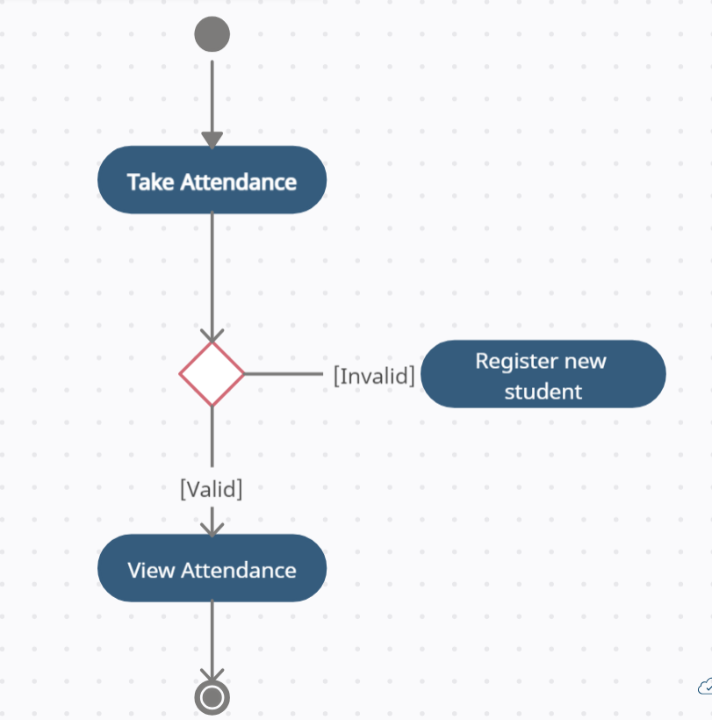
Student Activity Diagram

Slide 5
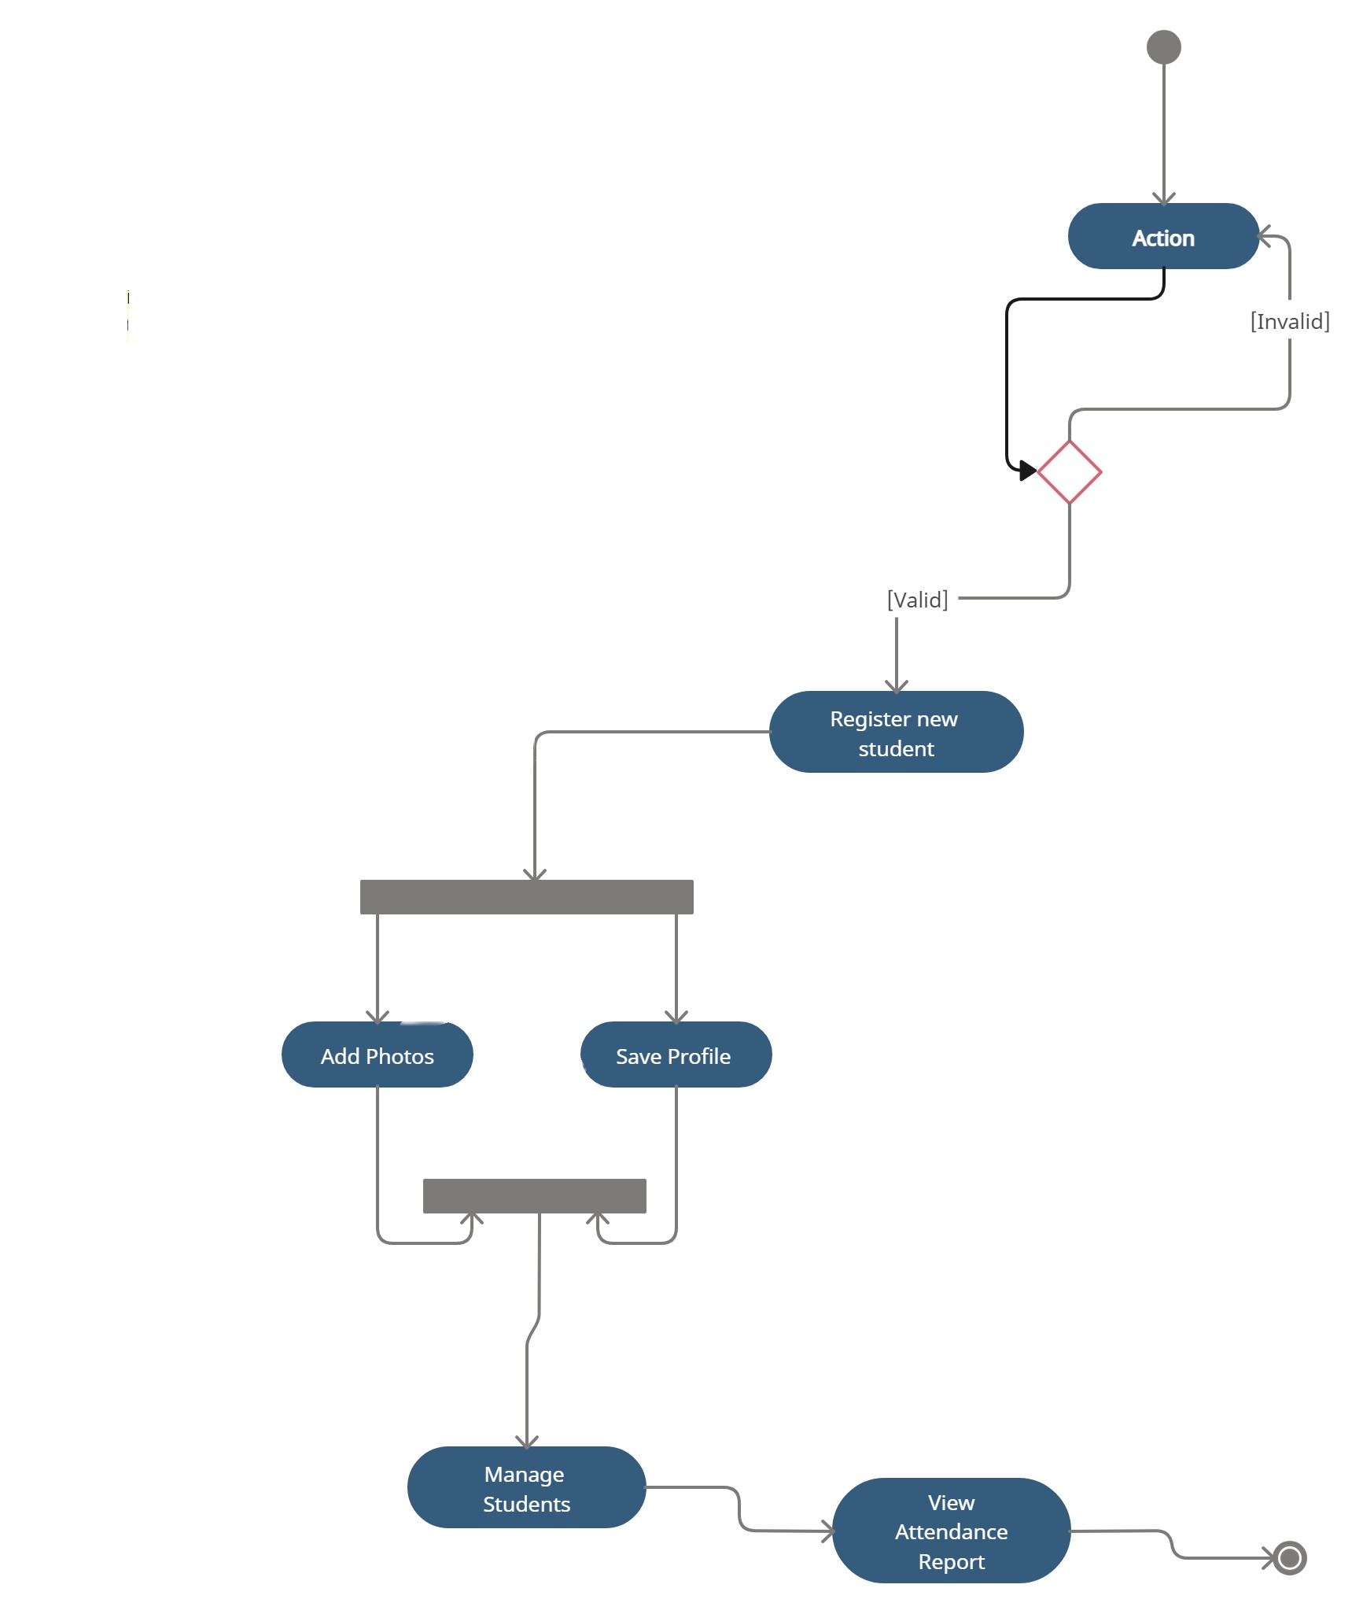
Admin Activity Diagram

Slide 6
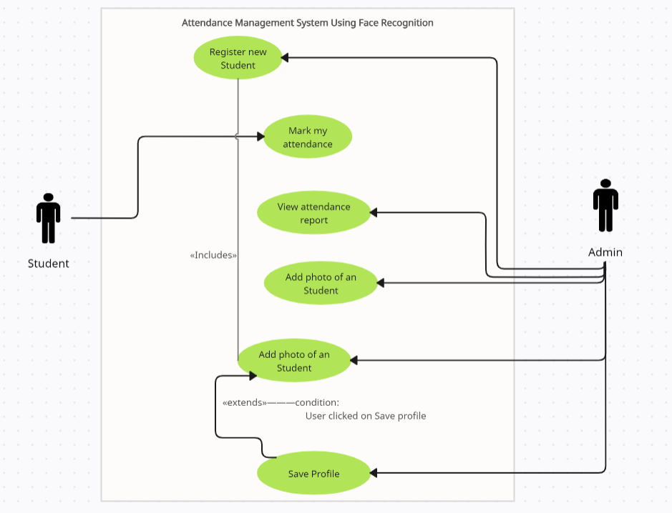
Usercase Diagram

